Slide 1
Chapter 1: Introduction to Systems Analysis and Design
Systems Analysis and Design with UML 2.0:
An Object-Oriented Approach, Second Edition
Robert Barker
Spring 2007

Slide 2
Discussion Topics
Role of the systems analyst in IT projects
Systems development methodologies

Slide 3
Systems Analyst
Understands the business and its processes
Identifies current problems and opportunities for improvement
Works with clients and users to define the problem
Develops models of the problem and its possible solutions
Works with IS professionals to implement and deploy a solution
Value Proposition
Concept
Delivery
Systems Analyst

Slide 4
IT Projects
Series of activities that move from concept through delivery
Activities are often grouped by type/phase
  Planning
  Requirements identification
  Analysis
  Design
  Implementation
  Test
Activities result in deliverables, where the output of one activity is the input to the next activity

Slide 5
Systems Development Methodologies
A formalized method of implementing the activities and phases of an IT project
  A set of processes to complete
  A set of deliverables to produce
Over time, several systems development methodologies have been proposed and practiced, based on different approaches to moving from concept through delivery

Slide 6
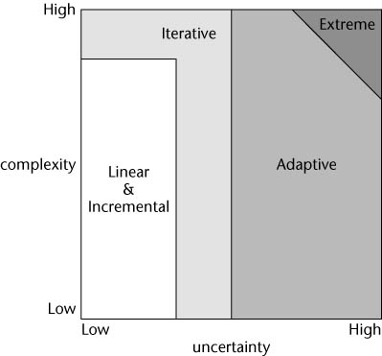
Categorizing Methodologies
Wysocki, Effective Software Project Management, 2006

Slide 7
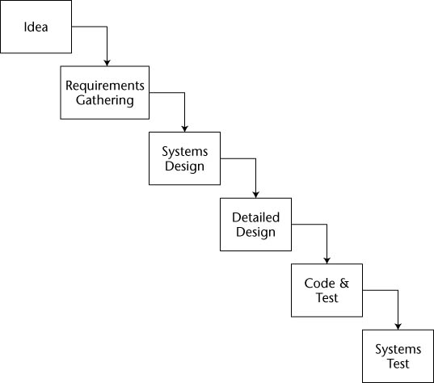
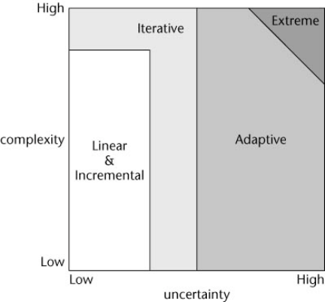
Linear Methodologies:
Waterfall Model
Linear: feed-forward, but no feedback
Wysocki, Effective Software Project Management, 2006

Slide 8
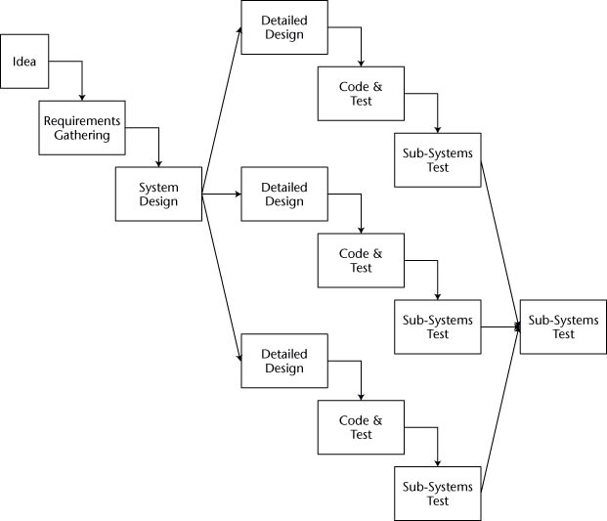
Linear Methodologies: Rapid Development Waterfall Model
Linear: feed-forward, but no feedback
Wysocki, Effective Software Project Management, 2006

Slide 9
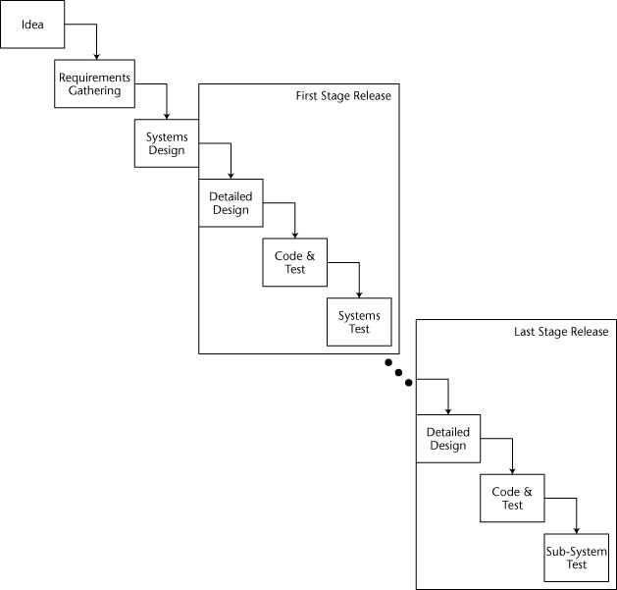
Incremental Methodologies: Staged Delivery Waterfall Model
Incremental: part now, part later
Wysocki, Effective Software Project Management, 2006

Slide 10
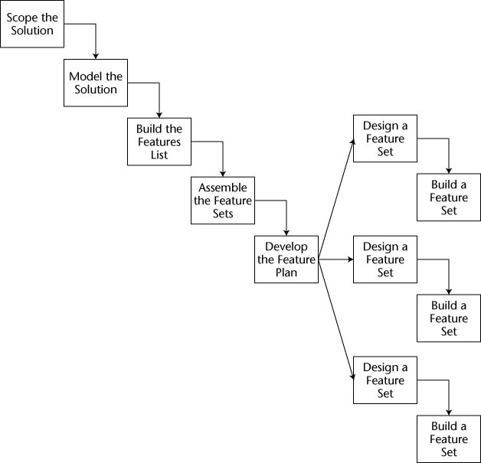
Incremental Methodologies: Feature-driven Development Model
Incremental: part now, part later
Wysocki, Effective Software Project Management, 2006

Slide 11
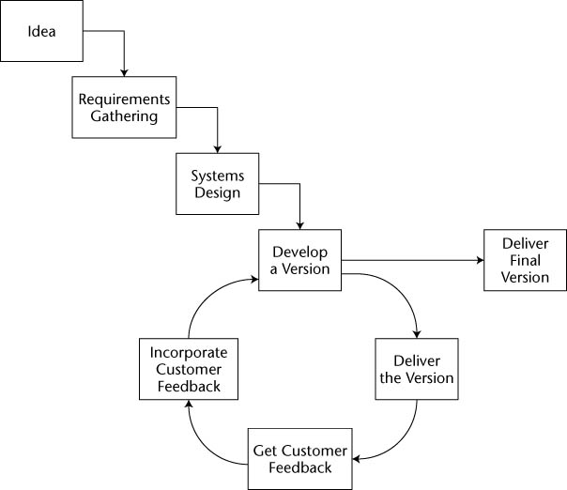
Iterative Methodologies: Evolutionary Development Waterfall Model
Iterative: feedback
Wysocki, Effective Software Project Management, 2006

Slide 12
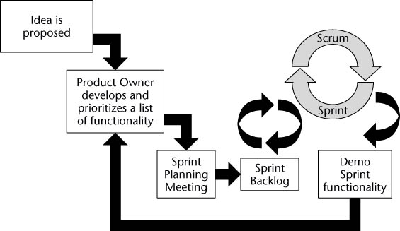
Iterative Methodologies: SCRUM
Iterative: feedback
Wysocki, Effective Software Project Management, 2006

Slide 13
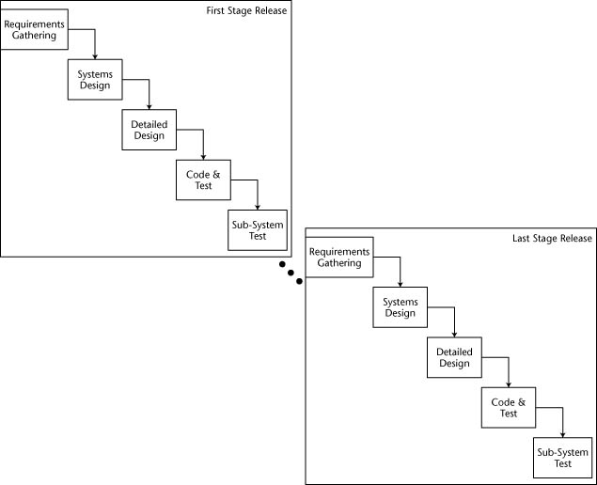
Iterative Methodologies:
Rational Unified Process
Iterative: feedback
Wysocki, Effective Software Project Management, 2006

Slide 14
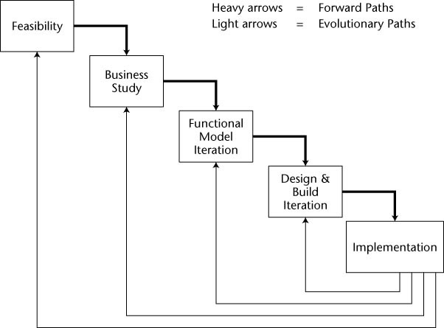
Iterative Methodologies: Dynamic Systems Development Method
Iterative: feedback
Wysocki, Effective Software Project Management, 2006

Slide 15
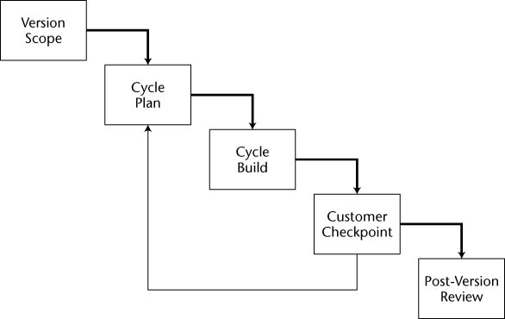
Adaptive Methodologies:
Adaptive Project Framework
Adaptive: feedback and discovery
Wysocki, Effective Software Project Management, 2006

Slide 16
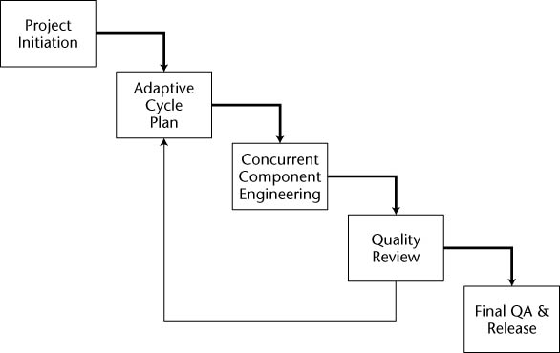
Adaptive Methodologies:
Adaptive Software Development
Adaptive: feedback and discovery of the solution
Wysocki, Effective Software Project Management, 2006

Slide 17
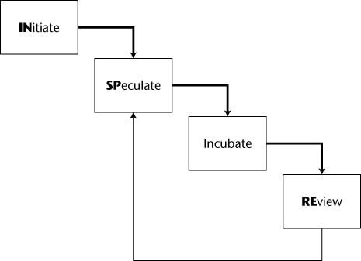
Extreme Methodologies:
INSPIRE
Extreme: feedback, research and development – the problem and solution are unknown
Wysocki, Effective Software Project Management, 2006

Slide 18
Questions and Exercises
How do the systems development methodologies listed in Chapter 1 of the SAD text (and accompanying notes) relate to the methodologies shown above?
Which methodology should you use?
What types of abilities and skills are required to become a systems analyst?

